Slide 1


Nelba Barreto
February 2024

Slide 2

Outline
Executive Summary
Introduction
Methodology
Results
Conclusion
Appendix

Slide 3
Executive Summary
Summary of methodologies
Summary of all results

Slide 4
Introduction
Project background and context
Problems you want to find answers

Slide 5

Section 1

Slide 6
Methodology
Executive Summary
Data collection methodology:
Data was obtained from the SpaceX REST API and by scraping the Wikipedia's List of Falcon 9 and Falcon Heavy launches page
Perform data wrangling
Data preparation involved encoding categorical variables into numerical representations, addressing missing data, and applying data transformations for enhanced analysis
Perform exploratory data analysis (EDA) using visualization and SQL
Perform interactive visual analytics using Folium and Plotly Dash
Perform predictive analysis using classification models
After splitting the data into training and test sets, various models were employed to predict the success (1) or failure (0) of the Falcon 9 first stage landing. Optimal hyperparameters were selected using GridSearchCV and evaluation metrics were then applied to assess the performance of each model

Slide 7


Data Collection
https://api.spacexdata.com/v4/launches/past
Additional information was extracted using nested API calls:
Rocket: Booster name
Launchpad: Launch site, longitude, latitude
Payload: Mass, orbit
Cores: Landing outcome, type, flight count, gridfins, reuse, legs, landing pad, block, reuse count, serial
https://en.wikipedia.org/wiki/List_of_Falcon_9_and_Falcon_Heavy_launches
Web scraping was performed to extract an HTML table containing Falcon 9 launch records
01
02
Data Sources
SpaceX REST API
Wikipedia’s List of Falcon 9 and Falcon Heavy launches page

Slide 8



Data Collection – SpaceX API
Make an API request to get SpaceX launch data
Construct the dataset from all the data obtained and create a new DataFrame
Convert JSON result to a DataFrame
Filter the DataFrame to only include Falcon 9 launches
https://github.com/NelbaBarreto/applied-data-science-capstone/blob/main/1_jupyter-labs-spacex-data-collection-api.ipynb
Iterate through the rocket, launchpad, payloads, and core columns of the DataFrame and make an API request to obtain additional information about each one to be stored in separate lists
Deal with missing values in the DataFrame

Slide 9
Data Collection - Scraping
Make an API request to get the Falcon9 Wiki page
Iterate through each th object of the table to extract all column names
https://github.com/NelbaBarreto/applied-data-science-capstone/blob/main/2_jupyter-labs-webscraping.ipynb
Create a BeautifulSoup object from the HTML response
Create a DataFrame by parsing the launch HTML tables
Using the BeautifulSoup object, find the table that contains the launch records

Slide 10
Data Wrangling
https://github.com/NelbaBarreto/applied-data-science-capstone/blob/main/3_labs-jupyter-spacex-Data%20wrangling.ipynb
Perform some Exploratory Data Analysis (EDA) on the dataset
Create a Class column using the Outcome column
Determine the number of launches on each site, the number and occurrence of each orbit, and the number of landing outcomes
Landing Outcomes | Landing Class | Meaning
True ASDS; True RTLS; True Ocean | 1 | Success
None None; False ASDS; False Ocean; None ASDS; False RTLS | 0 | Failure

Slide 11
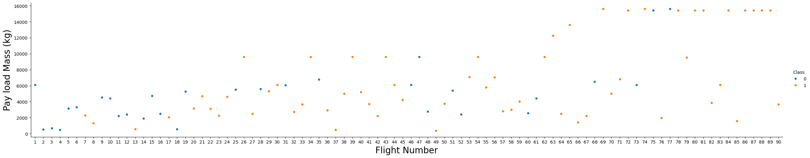
EDA with Data Visualization
Scatter plots were used to examine the relationship between two continuous variables
01
https://github.com/NelbaBarreto/applied-data-science-capstone/blob/main/5_jupyter-labs-eda-dataviz.ipynb
FlightNumber vs PayloadMass

Slide 12
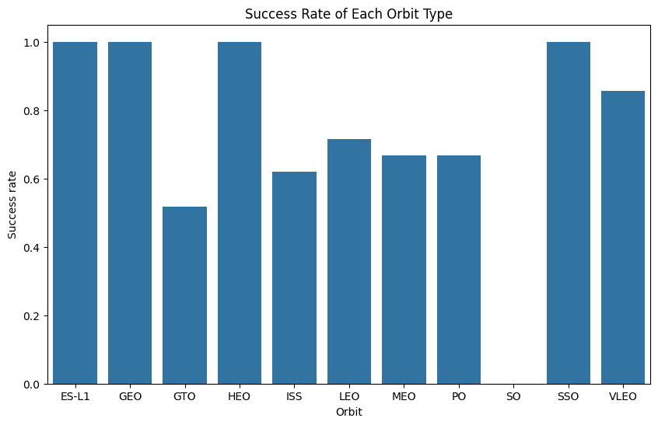
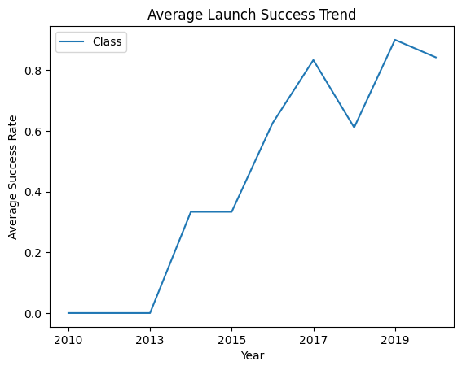
EDA with Data Visualization
02
03
A bar chart is used to make a comparison between categories
A line chart is to track the average success rate over time
https://github.com/NelbaBarreto/applied-data-science-capstone/blob/main/5_jupyter-labs-eda-dataviz.ipynb
Success Rate of Each Orbit Type
Average Launch Success Trend

Slide 13
EDA with SQL
The following information was obtained through SQL queries:
https://github.com/NelbaBarreto/applied-data-science-capstone/blob/main/4_jupyter-labs-eda-sql-coursera_sqllite.ipynb
The names of the unique launch sites in the space mission | The names of the boosters which have success in drone ship and have payload mass greater than 4000 but less than 6000
5 records where launch sites begin with the string ‘CCA’ | The total number of successful and failure mission outcomes
The total payload mass carried by boosters launched by Nasa (CRS) | The names of the booster_versions which have carried the maximum payload mass
The average payload mass carried by booster version F9 v1.1 | The date when the first successful landing outcome in group pad was achieved
The month names, failure landing_outcomes in drone ship, booster versions and launch_site for the months in year 2015 | The ranking of the count of landing outcomes between the date 2010-06-04 and 2017-03-20, in descending order

Slide 14
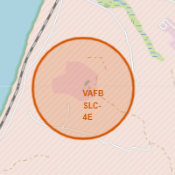
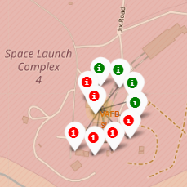
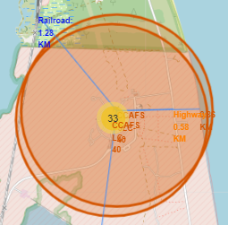
Build an Interactive Map with Folium
Folium was employed to uncover any discernible geographical patterns related to launch sites
Markers were used to add a marker on specific coordinates, representing each launch site and each launch
https://github.com/NelbaBarreto/applied-data-science-capstone/blob/main/6_lab_jupyter_launch_site_location.ipynb
Markers clusters were used to group markers in each launching site
Circles were used to add a highlighted circle area on specific coordinates
Lines were used to show the distances between a launch site to its proximities

Slide 15
Build a Dashboard with Plotly Dash
The dashboard includes the following plots, graphs, and interactive features:
A drop-down menu for selecting launch sites
01
https://github.com/NelbaBarreto/applied-data-science-capstone/blob/main/7_spacex_dash_app.py
A callback function that renders a pie chart, visualizing the counts of launch successes based on the selected launch site from the dropdown
02
A range slider for selecting payload parameters
03
A callback function that renders a scatter plot depicting Payload vs. Launch Outcome, based on the selected payload parameters
04

Slide 16
Predictive Analysis (Classification)
https://github.com/NelbaBarreto/applied-data-science-capstone/blob/main/8_SpaceX_Machine_Learning_Prediction_Part_5.ipynb
Create NumPy array for the target variable
Utilize GridSearchCV to train models for Logistic Regression, Support Vector Machine, Decision Tree Classifier, and K Nearest Neighbors
Standardize the feature data
Calculate the accuracy of each model on the test data to identify the most effective method
Split data into training and testing sets

Slide 17
Results
Exploratory data analysis results
Interactive analytics demo in screenshots
Predictive analysis results

Slide 18

Section 2

Slide 19
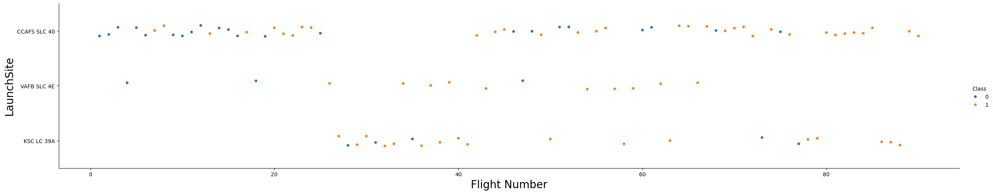
Flight Number vs. Launch Site

Slide 20
Payload vs. Launch Site
Show a scatter plot of Payload vs. Launch Site
Show the screenshot of the scatter plot with explanations

Slide 21
Success Rate vs. Orbit Type
Show a bar chart for the success rate of each orbit type
Show the screenshot of the scatter plot with explanations

Slide 22
Flight Number vs. Orbit Type
Show a scatter point of Flight number vs. Orbit type
Show the screenshot of the scatter plot with explanations

Slide 23
Payload vs. Orbit Type
Show a scatter point of payload vs. orbit type
Show the screenshot of the scatter plot with explanations

Slide 24
Launch Success Yearly Trend
Show a line chart of yearly average success rate
Show the screenshot of the scatter plot with explanations

Slide 25
All Launch Site Names
Find the names of the unique launch sites
Present your query result with a short explanation here

Slide 26
Launch Site Names Begin with 'CCA'
Find 5 records where launch sites begin with `CCA`
Present your query result with a short explanation here

Slide 27
Total Payload Mass
Calculate the total payload carried by boosters from NASA
Present your query result with a short explanation here

Slide 28
Average Payload Mass by F9 v1.1
Calculate the average payload mass carried by booster version F9 v1.1
Present your query result with a short explanation here

Slide 29
First Successful Ground Landing Date
Find the dates of the first successful landing outcome on ground pad
Present your query result with a short explanation here

Slide 30
Successful Drone Ship Landing with Payload between 4000 and 6000
List the names of boosters which have successfully landed on drone ship and had payload mass greater than 4000 but less than 6000
Present your query result with a short explanation here

Slide 31
Total Number of Successful and Failure Mission Outcomes
Calculate the total number of successful and failure mission outcomes
Present your query result with a short explanation here

Slide 32
Boosters Carried Maximum Payload
List the names of the booster which have carried the maximum payload mass
Present your query result with a short explanation here

Slide 33
2015 Launch Records
List the failed landing_outcomes in drone ship, their booster versions, and launch site names for in year 2015
Present your query result with a short explanation here

Slide 34
Rank Landing Outcomes Between 2010-06-04 and 2017-03-20
Rank the count of landing outcomes (such as Failure (drone ship) or Success (ground pad)) between the date 2010-06-04 and 2017-03-20, in descending order
Present your query result with a short explanation here

Slide 35

Section 3

Slide 36
<Folium Map Screenshot 1>
Replace <Folium map screenshot 1> title with an appropriate title
Explore the generated folium map and make a proper screenshot to include all launch sites’ location markers on a global map
Explain the important elements and findings on the screenshot

Slide 37
<Folium Map Screenshot 2>
Replace <Folium map screenshot 2> title with an appropriate title
Explore the folium map and make a proper screenshot to show the color-labeled launch outcomes on the map
Explain the important elements and findings on the screenshot

Slide 38
<Folium Map Screenshot 3>
Replace <Folium map screenshot 3> title with an appropriate title
Explore the generated folium map and show the screenshot of a selected launch site to its proximities such as railway, highway, coastline, with distance calculated and displayed
Explain the important elements and findings on the screenshot

Slide 39

Section 4

Slide 40
<Dashboard Screenshot 1>
Replace <Dashboard screenshot 1> title with an appropriate title
Show the screenshot of launch success count for all sites, in a piechart
Explain the important elements and findings on the screenshot

Slide 41
<Dashboard Screenshot 2>
Replace <Dashboard screenshot 2> title with an appropriate title
Show the screenshot of the piechart for the launch site with highest launch success ratio
Explain the important elements and findings on the screenshot

Slide 42
<Dashboard Screenshot 3>
Replace <Dashboard screenshot 3> title with an appropriate title
Show screenshots of Payload vs. Launch Outcome scatter plot for all sites, with different payload selected in the range slider
Explain the important elements and findings on the screenshot, such as which payload range or booster version have the largest success rate, etc.

Slide 43

Section 5

Slide 44
Classification Accuracy
Visualize the built model accuracy for all built classification models, in a bar chart
Find which model has the highest classification accuracy

Slide 45
Confusion Matrix
Show the confusion matrix of the best performing model with an explanation

Slide 46
Conclusions
Point 1
Point 2
Point 3
Point 4
…

Slide 47
Appendix
Include any relevant assets like Python code snippets, SQL queries, charts, Notebook outputs, or data sets that you may have created during this project

Slide 48


